Slide 1
Pixelwise Instance Segmentation with Dynamically Instantiated Network
PRATHYUSHA AKUNDI (2018701014)
SOWMYA AITHA (2018702007)
TANU SHARMA (2018702012)

Slide 2
Abstract
Instance segmentation system produces a segmentation map where each pixel is assigned an object class and instance identity label using an object detector and end-to-end CRF to predict instances.
This is dynamically instantiated to produce variable number of instances per image.

Slide 3
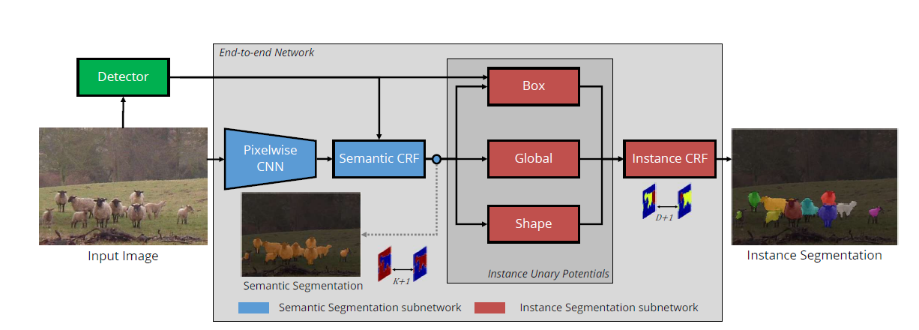
Architecture

Slide 4
OBJECT DETECTION
Tensorflow Object Detection API
Dataset used for training: MS COCO 2017
Pre-trained MobileNet model
INPUT : RGB Image
OUTPUT : No of Detections ‘D’ and for every detection i we get (l_{i} , s_{i}, B_{i} ) where
l_{i} ∈ L is the detected classlabel
s_{i} ∈ [0, 1] is the confidence score
B_{i} is the set of indices of the pixels falling within the detector’s bounding box.

Slide 5
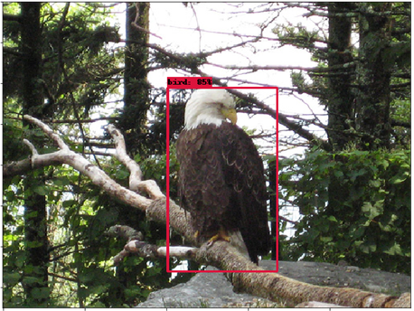
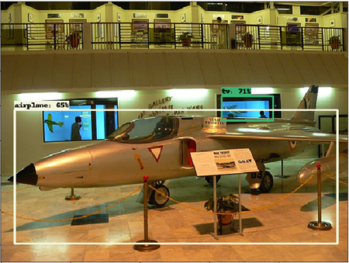
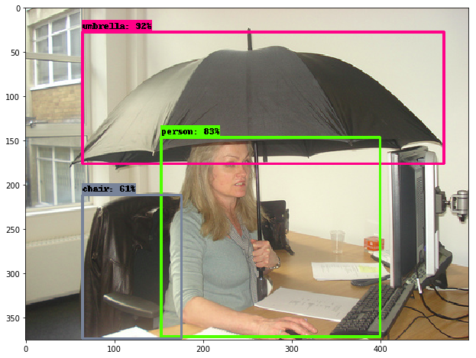
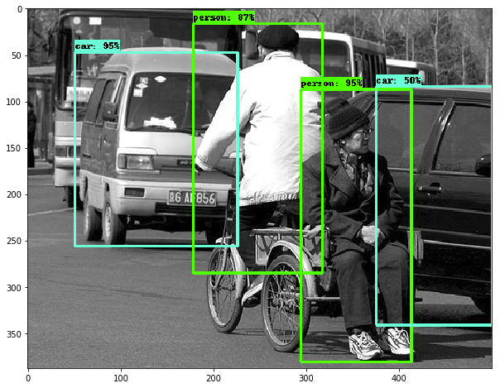
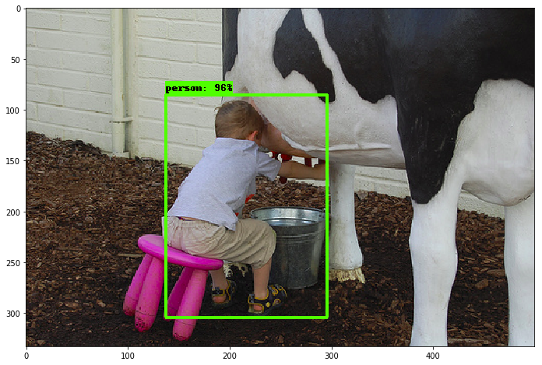
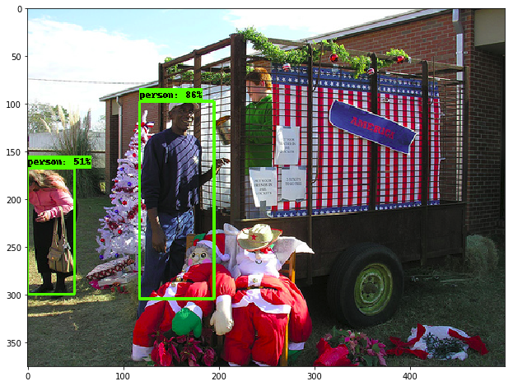
RESULTS (Object Detection)

Slide 6
Semantic Segmentation Subnetwork
FCN8s architecture which is based on the VGG ImageNet model.
CRF as RNN as the module’s last layer which contains densely-connected pairwise potentials and higher order detection potential
INPUT : RGB Image
OUTPUT : Tensor Q where Q_{i}(l) denotes the probability of pixel i taking on the label l ∈ L.

Slide 7
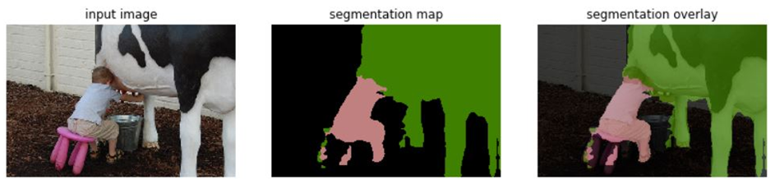
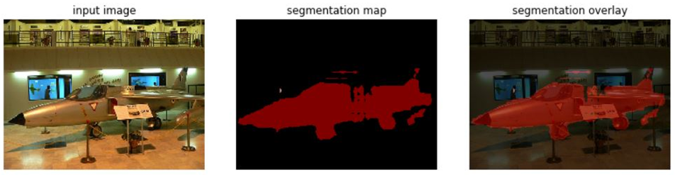
RESULTS(Semantic Segmentation)

Slide 8
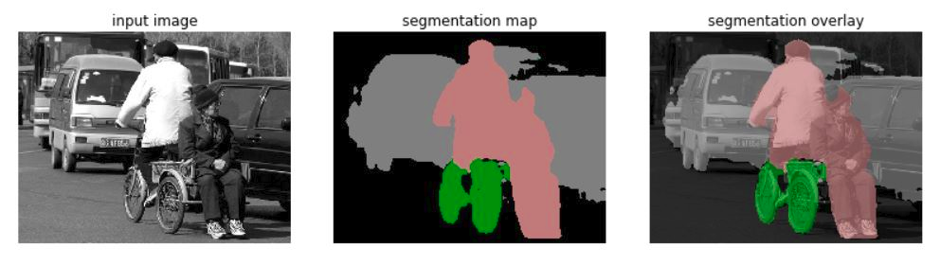
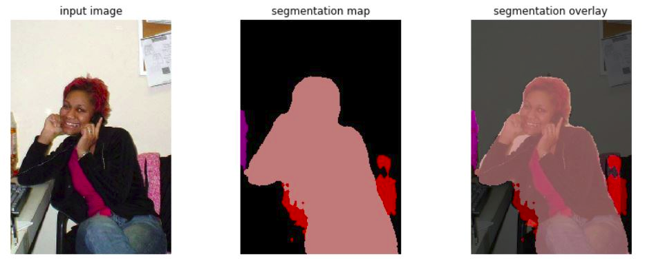
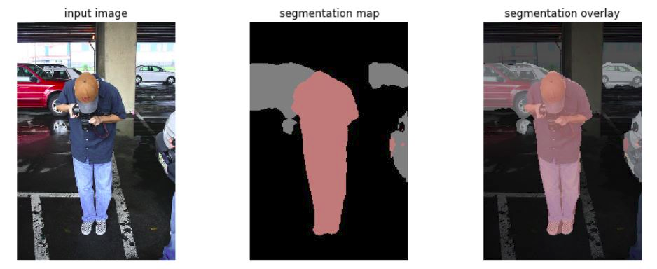
RESULTS(Semantic Segmentation)

Slide 9
Instance Segmentation Subnetwork
Assigns every pixel to either a particular object detection or the background label
The quality of a prediction is invariant to the permutations of instance labelling, it is handled by the loss function
INPUTS : Semantic Segmentation Predictions(Q) for each pixel and a set of object detections
OUTPUTS: Tensor Q where Q_{i}(l) denotes the probability of pixel i taking on the label l ∈ {1,2,...N} where N is the number of object detections in the image.

Slide 10
Conditional Random Fields
A probabilistic model to segment and label
If I is the image with V label assigned to it, then pair (I,V) can be modelled as a CRF,
Pr(V = v|I) = (1/Z(I)) exp(−E(v|I))
Minimising E(v), energy of assignment, yields MAP labelling
Dense pairwise potentials => exact inference not tractable, so mean field inference is used

Slide 11
CRF Potentials
Consists of unary and pairwise potentials
Energy of assignment of label v to pixels V,
E(V=v)=Σ_{i}U(v_{i})+Σ_{i<j} P(v_{i},v_{j})
Unary potential for instance subnetwork is,
U( v_{i} ) = −ln[ w₁ ψ_{Box} ( v_{i} ) + w₂ψ_{Global} ( v_{i} )+w₃ ψ_{Shape}( v_{i} ) ]

Slide 12
Box Term
Encourages a pixel to be assigned to the instance corresponding to the k^{th} detection if it falls within the detections bounding box.
ψ_{Box} (V_{i} = k) = Q_{i}(l_{k} )s_{k} if i∈ B_{k}
= 0 otherwise
s_{k} = detection score

Slide 13
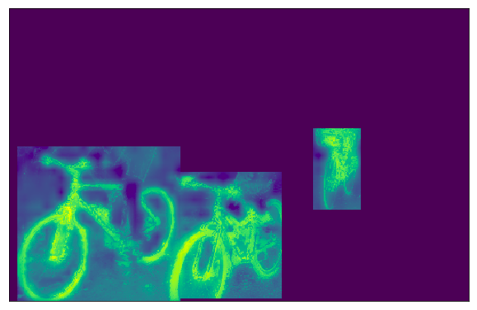
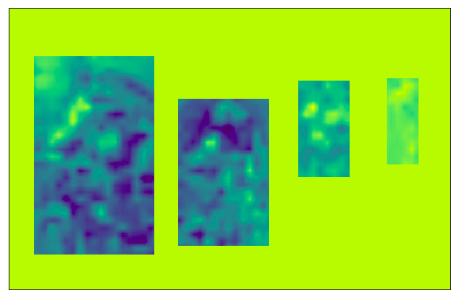
Box Term
Box term(Cycle)
Box term(Person)

Slide 14
Global Term
Does not rely on bounding boxes, but only on the segmentation prediction at a particular pixel, Q_{i} .
ψ_{Global} (V_{i} = k) = Q_{i}(l_{k} )
Overcomes cases where the bounding box does not cover the entire extent of the object.

Slide 15
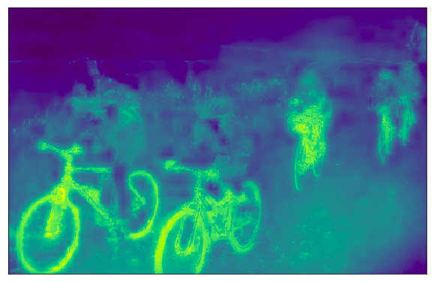
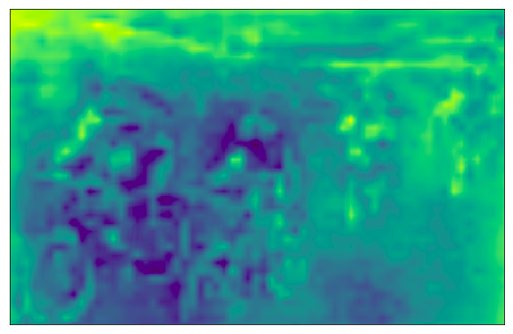
Global Term
Global term(Cycle)
Global term(Person)

Slide 16
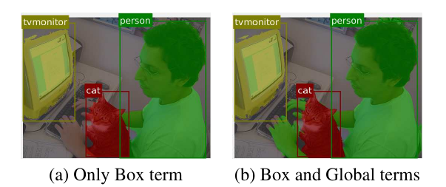
Box and Global Term

Slide 17
Shape Term
Incorporated to help reason about occlusions
Shape term is,
ψ(V_{Bk}=k) = Q_{Bk}(l_{k}) ⊙ t*
t* =arg max_{t∊T} (Q_{Bk}(l_{k}) ⊙ t) / (|| Q_{Bk}(l_{k})|| ⊙ ||t||)
Where,
T = Shape templates
Q_{Bk}(l_{k}) = segmentation prediction for the detected class within the bounding box

Slide 18
Pairwise Term
Encourages appearance and spatial consistency
Resolves occlusion based on appearance differences between objects of same class
P(v_{i},v_{j}) = μ(v_{i},v_{j}) ∑_{m=1}^{K} w^{(m)}k^{(m)}(f_{i},f_{j})
Where,
f_{i},f_{j} = feature vectors for pixel i and j in arbitrary feature space
μ is a label compatibility function

Slide 19
Loss Function
Single loss function (cross-entropy) to backpropagate through instance and semantic segmentation modules to update all the parameters
Match the original ground truth to instance segmentation prediction based on the IoU.
G* = arg max_{m∈M} IoU(m, P)
Formulated as a Maximum-weight bipartite matching problem.

Slide 20
Validation Metrics
Unary Potential Terms Included | AP^{0.5}
Box Term | 43.8
Box + Global Term | 43.9
Box + Global Term + Shape Term | 43.9

Slide 21
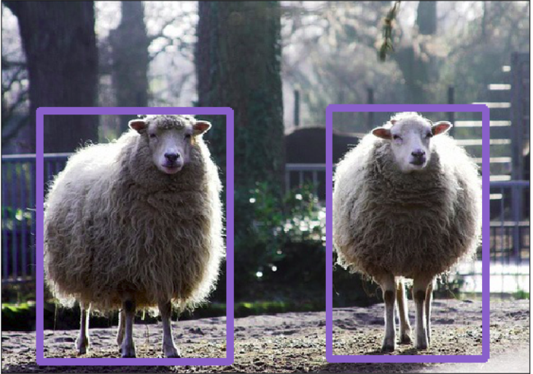

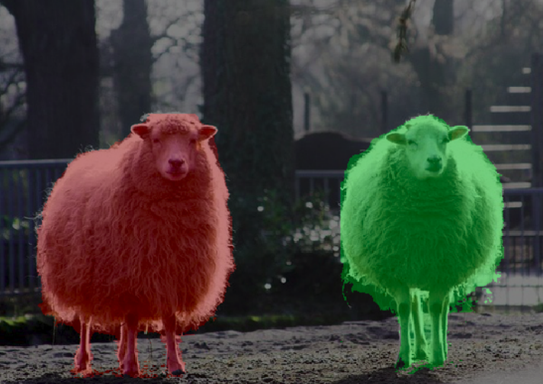
Success Cases

Slide 22
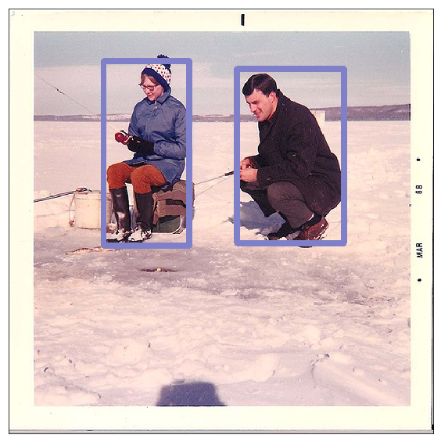

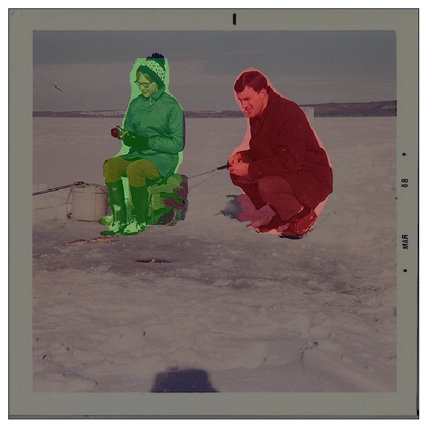
Success Cases

Slide 23
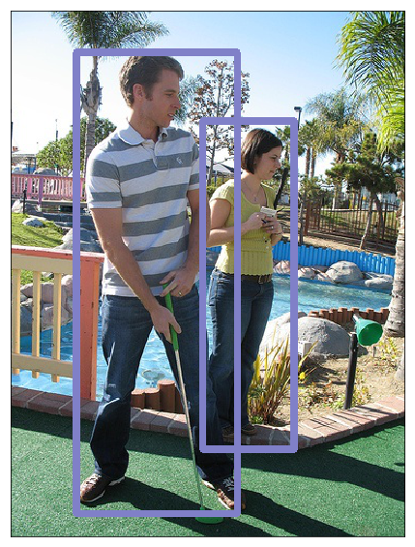
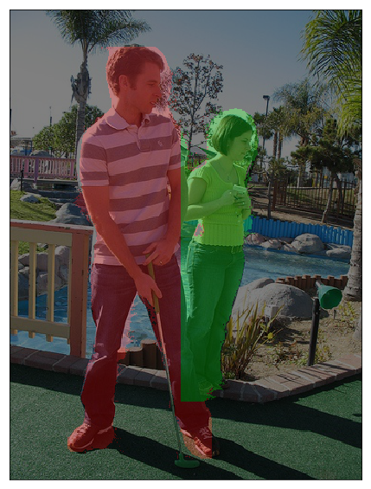

Success Cases

Slide 24
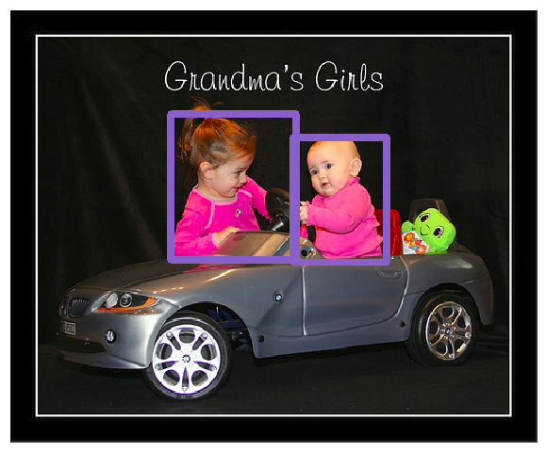

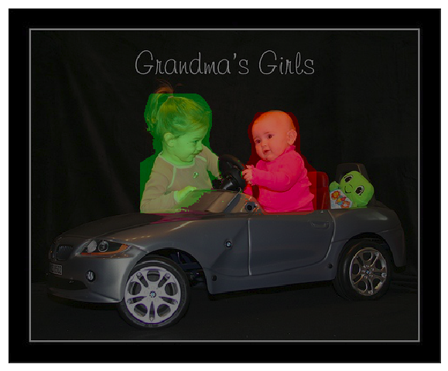
Failure Cases

Slide 25
GITHUB LINK
https://github.com/Prathyusha-Akundi/Pixelwise_Instance_Segmentation.git

Slide 26
REFERENCES
A. Arnab and P. H. S. Torr. Pixelwise instance segmentation with a dynamically instantiated network. In CVPR, 2017
S. Zheng, S. Jayasumana, B. Romera-Paredes, V. Vineet, Z. Su, D. Du, C. Huang, and P. Torr. Conditional random fields as recurrent neural networks
D. Weiss and B. Taskar. Scalpel: Segmentation cascades with localized priors and efficient learning
Xuming He Richard S. Zemel Miguel A. ´Carreira-Perpin˜an. ‘Multiscale Conditional Random Fields for Image Labeling’

